Slide 1
Course Wrap-up & TA-led Activities
CSE 390B Victory Lap, End of Quarter TA-led Activities

Slide 2
Lecture Outline
CSE 390B Victory Lap
Nand2Tetris Projects and Metacognitive Subjects
End of Quarter TA-led Activities
TA Ask Me Anything & Jeopardy

Slide 3
Remember this?
The UW Student Experience
Math
Metacognitive
Skills
CSE
Nand2Tetris
Projects
Sociology
CSE 390B

Slide 4
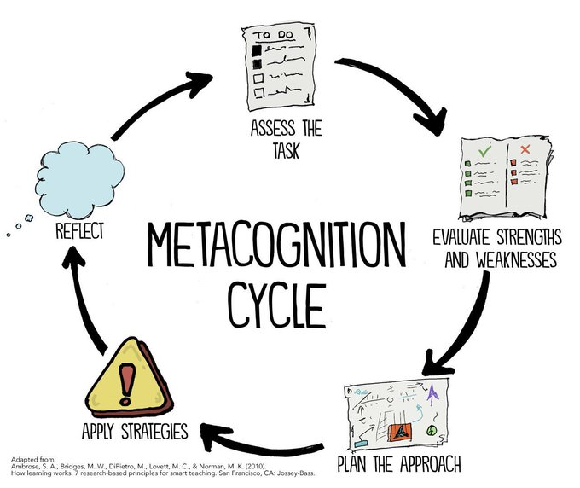
Metacognitive Skills Victory Lap
Time Management
Note-Taking
Annotation
Exam Preparation & Test-Taking
Debugging
Working with Instructors & TAs
Oral Communication

Slide 5
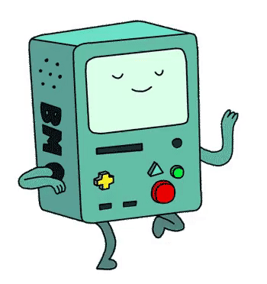
Nand2Tetris Projects
By building a computer, you’ve accomplished something that very few others have done!
Many software writers consider building the computer as Somebody Else’s Problem™
But so many technical skills and CSE courses tie into this task
And even if you only write Java for the rest of time…
Understanding the “layer below” makes you a better engineer in the “layer above”!

Slide 6
Roadmap
SOFTWARE
HARDWARE
High-Level Language
Intermediate Language(s)
Assembly Language
Operating System
Assembler
Machine Code
Computer
Memory
CPU
ALU
PC
Basic Logic Gates
NAND

Slide 7
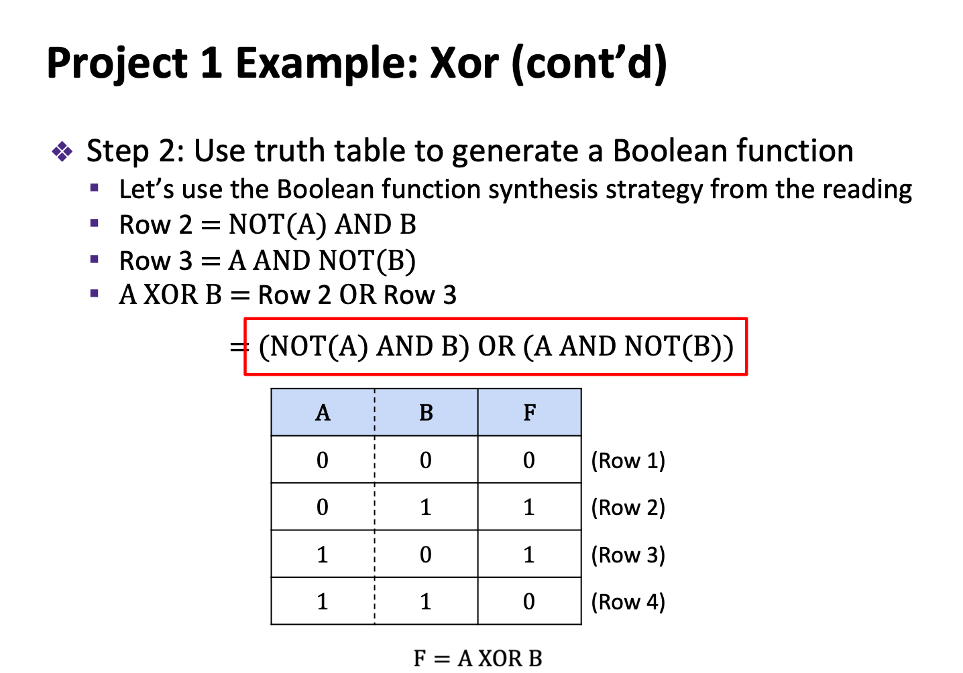
Boolean function synthesis
Practice with HDL—an unfamiliar, declarative style of programming
Project 2
Basic Logic Gates
NAND

Slide 8
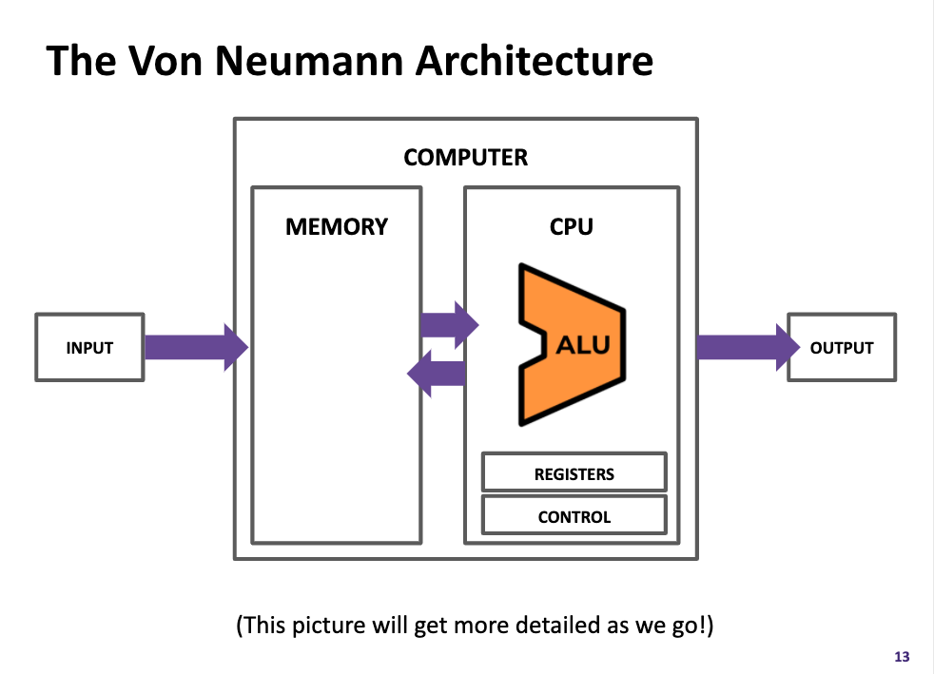
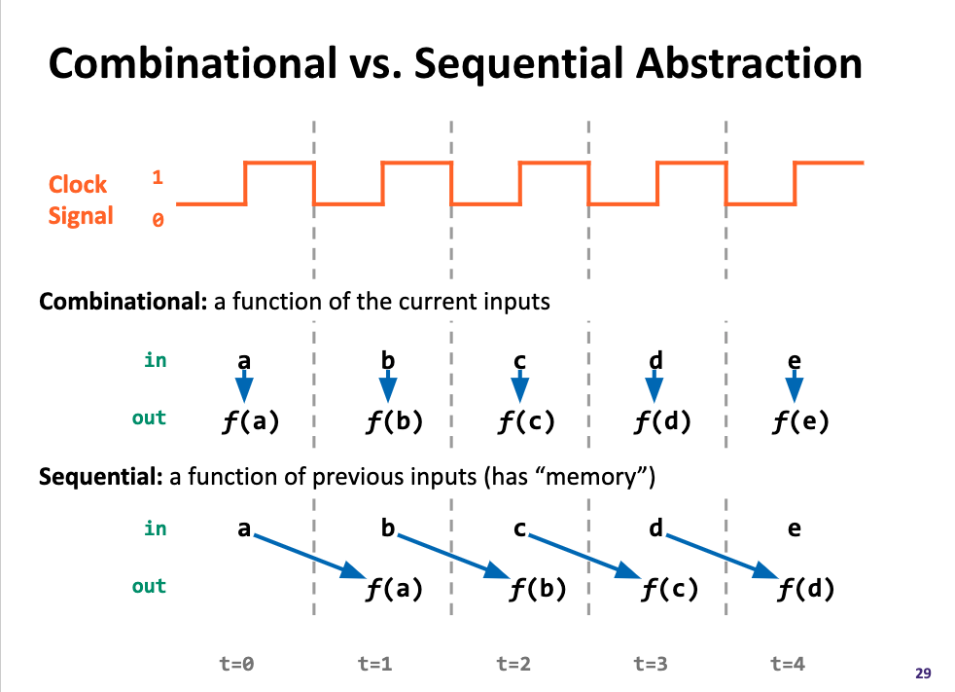
Components found in real-world computers: ALU, PC, Memory, etc.
Learning a mental model for sequential logic
Project 4
Memory
Project 3
ALU
PC
Basic Logic Gates
NAND

Slide 9
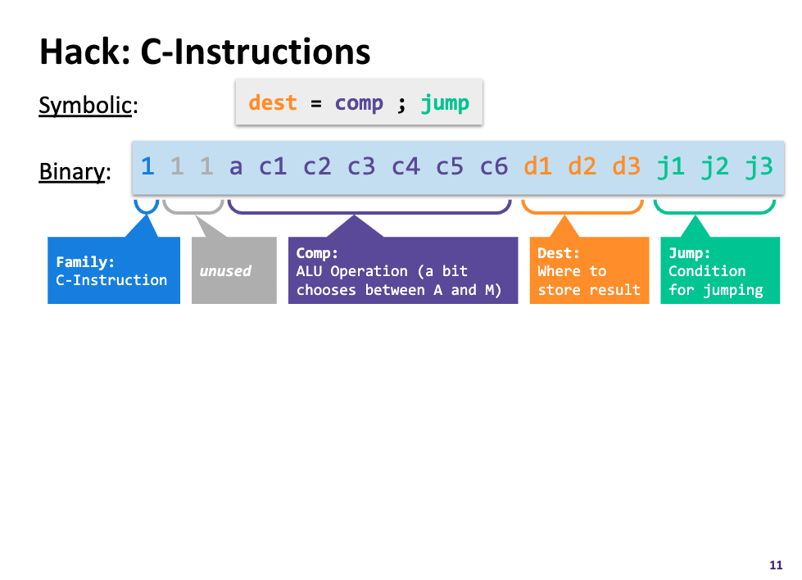
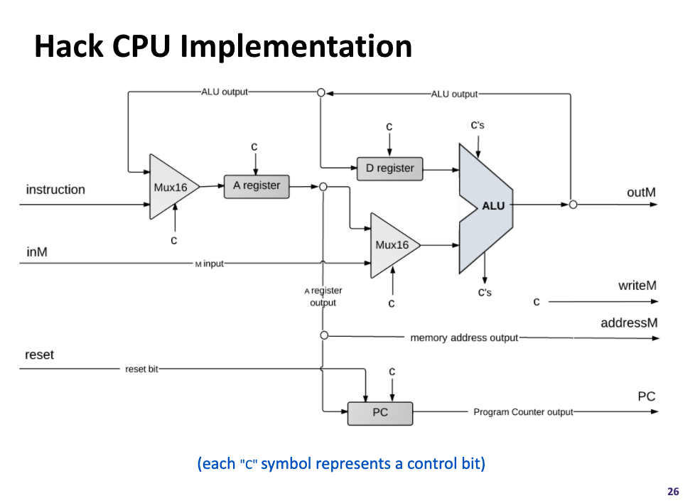
Project 5
Assembly Language
Assembler
Machine Code
Project 6
Computer
Memory
CPU
The connection between software and hardware through binary instructions
What must happen in a clock cycle to process one instruction
ALU
PC
Basic Logic Gates
NAND

Slide 10
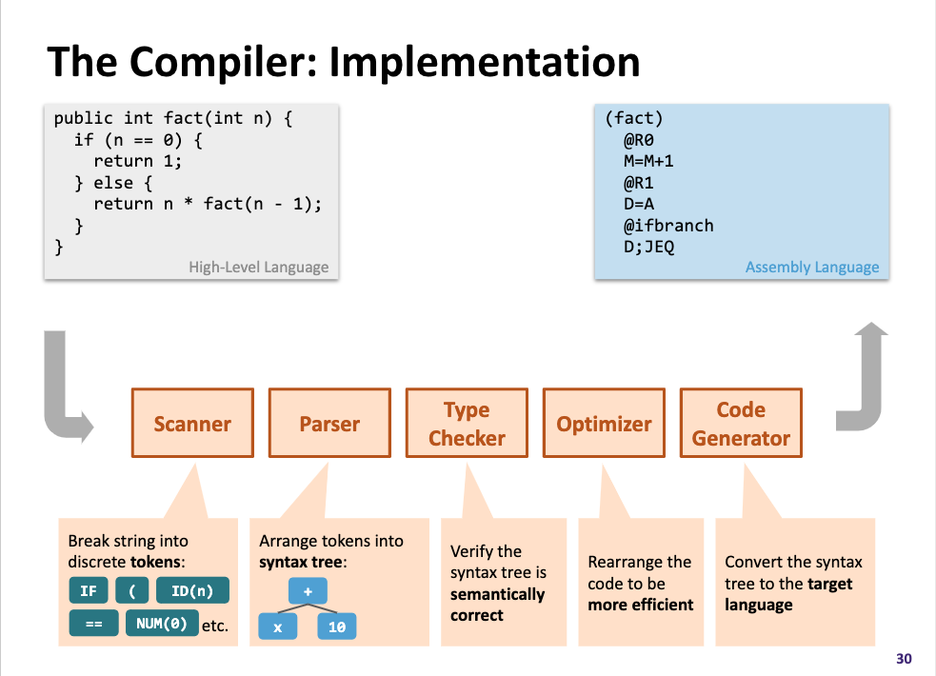
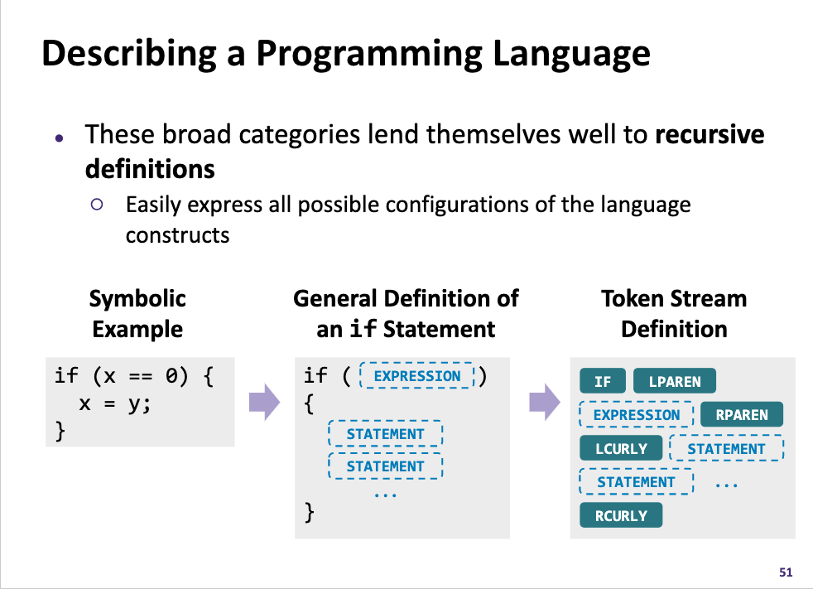
High-Level Language
Project 8
Intermediate Language(s)
Assembly Language
Operating System
Assembler
Machine Code
Computer
Memory
CPU
What happens when you click that green run button?
Programs can read in programs and then spit out equivalent programs
ALU
PC
Basic Logic Gates
NAND

Slide 11
Takeaways: Why Build a Computer?
A significant engineering effort
You practiced so many skills and programmed with so many different languages, tools, & paradigms—and you can do it again!
We hope this was a demystifying experience
To not see CSE courses as isolated but as interconnected puzzle pieces
We hope you had fun in this learning journey!
The computing field is broad and has much for you to explore
We are hopeful you found a topic you want to pursue further, both technically and metacognitively

Slide 12
SOFTWARE
HARDWARE
331: Software Design 332: Data Structures 421: Algorithms
446: ML … & many more
341: Programming Languages
High-Level Language
Intermediate Language(s)
401: Compilers
333: Systems Programming
Assembly Language
Operating System
451: Operating Systems
452: Distributed Systems
461: Networks
Assembler
351: HW/SW Interface
Machine Code
Computer
Memory
CPU
469: Computer Architecture
ALU
PC
311: Foundations I
Basic Logic Gates
369: Digital Design
NAND
371: Digital Circuits

Slide 13
Five-minute Break!
Feel free to stand up, stretch, use the restroom, drink some water, review your notes, or ask questions
We’ll be back at:
Research shows mid-lecture breaks reduce the decline of attention in the middle of lecture (Olmsted, 1999)
Olmsted III, John. “The Mid-Lecture Break: When Less Is More.” Journal of Chemical Education (1999). https://pubs.acs.org/doi/abs/10.1021/ed076p525.

Slide 14
Lecture Outline
CSE 390B Victory Lap
Nand2Tetris Projects and Metacognitive Subjects
End of Quarter TA-led Activities
TA Ask Me Anything & Jeopardy

Slide 15
TA Ask Us Anything!
Ask us about…
Classes
Recommendations for easy, hard, useful, etc. classes
What classes go well with each other
Extracurricular activities
TAing
Allen School RSOs
UW RSOs
Internships
How we feel about CS…

Slide 16
Jeopardy!
Organize into teams of 3-4 students
The first team to raise their hand and answer the question wins that round and chooses the next question

Slide 17
Lecture 20 Wrap-up
Office Hours and Student-TA 1:1 meetings end this week
Course staff open to meeting during finals week by appointment
Project Reminders
Final Project, Part I: Outline of E-Portfolio due tonight (6/2) at 11:59pm PDT
Submission can be a text entry box, a website URL, a media recording, a file upload, or a draft of your E-Portfolio
Final Project, Part II: Final E-Portfolio Submission due next Tuesday at 4pm PDT (right before we meet for final presentations)
If you have any uncompleted projects, the last day to turn them in is this Friday (6/3) at 11:59pm PDT

Slide 18
Lecture 20 Wrap-up
Please fill out the CSE 390B course evaluation if you have not already
Linked here: https://uw.iasystem.org/survey/260462
Looking forward to your final presentations next Tuesday!

